Slide 1
Thyroid

Slide 2
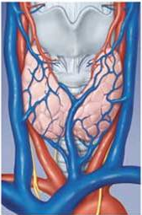
Anatomy
Formed of two+ lobes connected by an isthmus
Weighs about 20 grams
Located From the middle of the thyroid cartilage up to the 6th tracheal ring
Divided In to lobules that contain 20 to 40 follicles each Connected by isthmus found at 2nd to 4th tracheal ring
Perfusion to mass ratio is second only to adrenal gland (highly vascular)
Superior and Inferior thyroid arteries

Slide 3
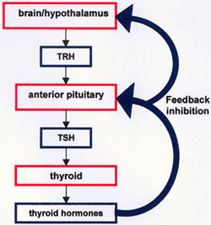
physiology
Hypothalamo – pituitary – thyroid axis controls secretion
Produces T3 and T4
T3 only 20% is produced from thyroid
80% peripheral conversion of T4 to T3
T3 is 4times potent than T4

Slide 4
Effects of thyroid hormones
Affects almost every system in the body
Fetal brain & skeletal development
Increase O₂ consumption, BMR & heat production
Positive inotropic and chronotropic on heart
Increased GI motility,etc.

Slide 5
Disorders of Thyroid
Abnormal thyroid function
Hyperthyroidism
Hypothyroidism
Thyroid enlargement

Slide 6
Goiter
Any enlargement of the thyroid gland
Goiters may be diffuse, uni-nodular, or multinodular
Can be toxic or non toxic
Benign or malignant
endemic goiter - goiter in a significant proportion of individuals in a particular geographic region

Slide 7
hyperthyroidism
Hyperthyroidism excess synthesis and secretion of thyroid hormones by the thyroid gland
Thyrotoxicosis is a clinical state of thyroid hormone excess of any source
Graves’ disease, toxic multinodular goiter (Plummer’s disease), and solitary toxic nodule are most relevant to the surgeon
More in females and affects 4-5% of population
Diffuse Toxic Goiter (Graves’ Disease) – commonest
Ophthalmopathy (50%) - Lid lag , Periorbital edema, blindness
Dermopathy
Gynecomastia
Thyroid acropachy

Slide 8
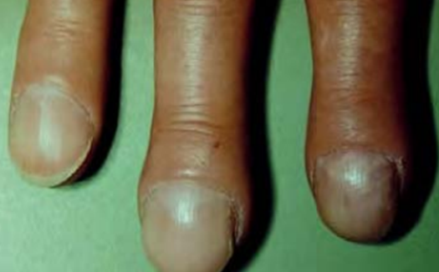
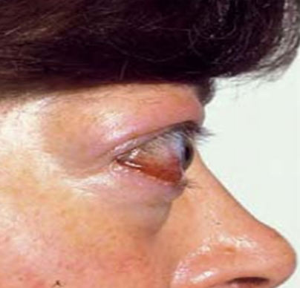
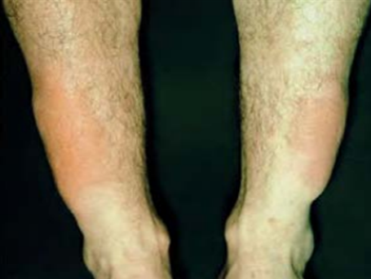
Cont.
Clinical features

Slide 9
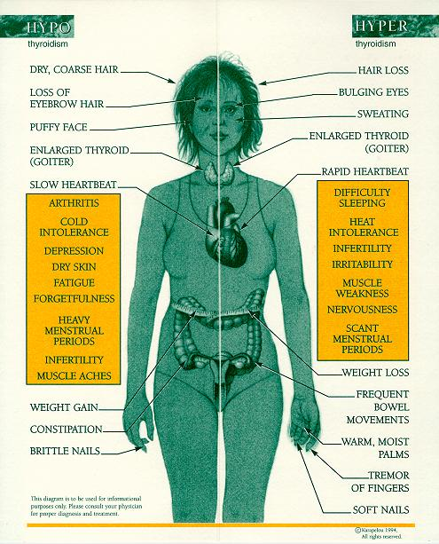

Slide 10
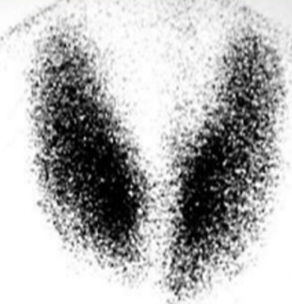
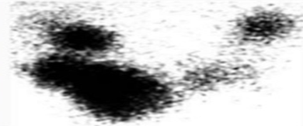
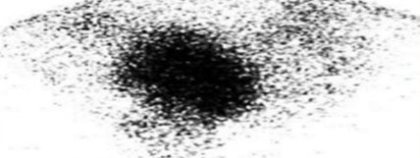
Diagnosis
TFT
The diagnosis of hyperthyroidism is made by a suppressed TSH with or without an elevated free T3 or T4 level
Thyroid scan
imaging

Slide 11
Treatment
Antithyroid drugs
Beta blockers
Thyroid ablation with radioactive ¹³¹I
Thyroidectomy

Slide 12
Malignant thyroid diseases
It is the most common endocrine malignancy,
F: M– 2.5:1
Differentiated
Papillary thyroid ca, follicular thyroid ca, Hürthle Cell Carcinoma
Poorly differentiated
Medullary , anaplastic
Lymphoma
Metastatic – rare- kidney, breast, lung, and melanoma

Slide 13
workup
FNAB
Neck u/s
Ultrasound, CT, MRI
Serum calcitonin and serum CEA
Serum calcium
laryngoscopy

Slide 14
Treatment
Surgery - lobectomy and isthmusectomy, total thyroidectomy +/- neck dissection
Chemotherapy
radiotherapy

Slide 15
Complications of thyroidectomy
Intraop – bleeding, adjacent organ injury (RLN, SLN), thyroid storm
Thyroid artery, Thyroid vein, Thyroid remnant
Immediate – upper airway obstruction, bleeding
Hematoma, Bilateral RLN, Hypocalcaemic laryngeal spasm, Laryngeal edema, tracheomalacia
Early – hypocalcaemia, RLN and SLN damage
Late – hypothyroidism and hypoparathyroidism

Slide 16
Breast

Slide 17
Anatomy
Located with in the superficial fascia of anterior chest wall.
From 2nd to 6th rib
From lateral boarder of sternum to the mid axillary line.
Blood supply is from
Perforating branches of the internal mammary
Branches from the axillary artery (lateral mammary branches)
Lateral branches of the posterior intercostal arteries
veins follow arteries

Slide 18
Axilla - Anatomy
A pyramidal space
Apex: cervicoaxillary canal – a triangular space: clavicle, scapula, first rib.
Base: axillary fascia
Anterior wall: Clavipectoral fascia containing p. major, p. minor and subclavius.
Posterior wall: scapula and three muscles (subscapularis, latismus dorsi and teres major)
Medial wall: lateral chest wall 2nd to 6th ribs and serratus anterior wall
Lateral wall: bicipital groove of humerus.

Slide 19
Lymphatic drainage of the breast
Axillary lymph nodes
Anterior, Pectoral (External mammary) nodes
Scapular, posterior nodes
Lateral nodes:
Central nodes: largest group and easily palpable.
Apical nodes
Interpectoral nodes; smallest group
Internal mammary lymph nodes
(Infraclavicular, Supraclavicular)

Slide 20
Levels (according to their anatomic relationship to the pectoralis minor muscle)
Level I
Lymph nodes located lateral to or below the lower border of the pectoralis minor muscle
Level 2
Lymph nodes located superficial or deep to the pectoralis minor muscle
Level 3
Lymph nodes located medial to or above the upper border of the pectoralis minor muscle

Slide 21
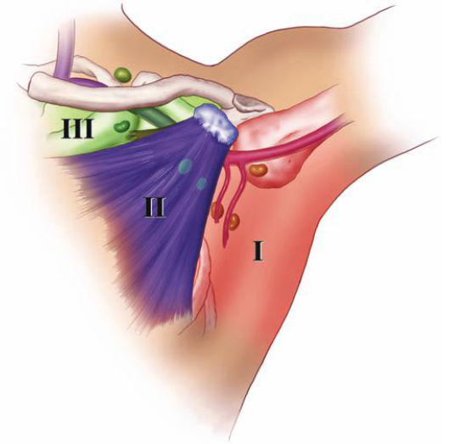

Slide 22
Malignant lesions

Slide 23
Breast ca
Major cause of cancer deaths in women
Occurs in 1 of 9 women in US
Risk factors:
genetic, BRCA1 and BRCA2 , lafraumeni syndrome
Hormonal - risk increases with early menarche, late menopause, nulliparity, having first child after age 30
Environmental - thought due to high fat diet and heavy alcohol use;

Slide 24
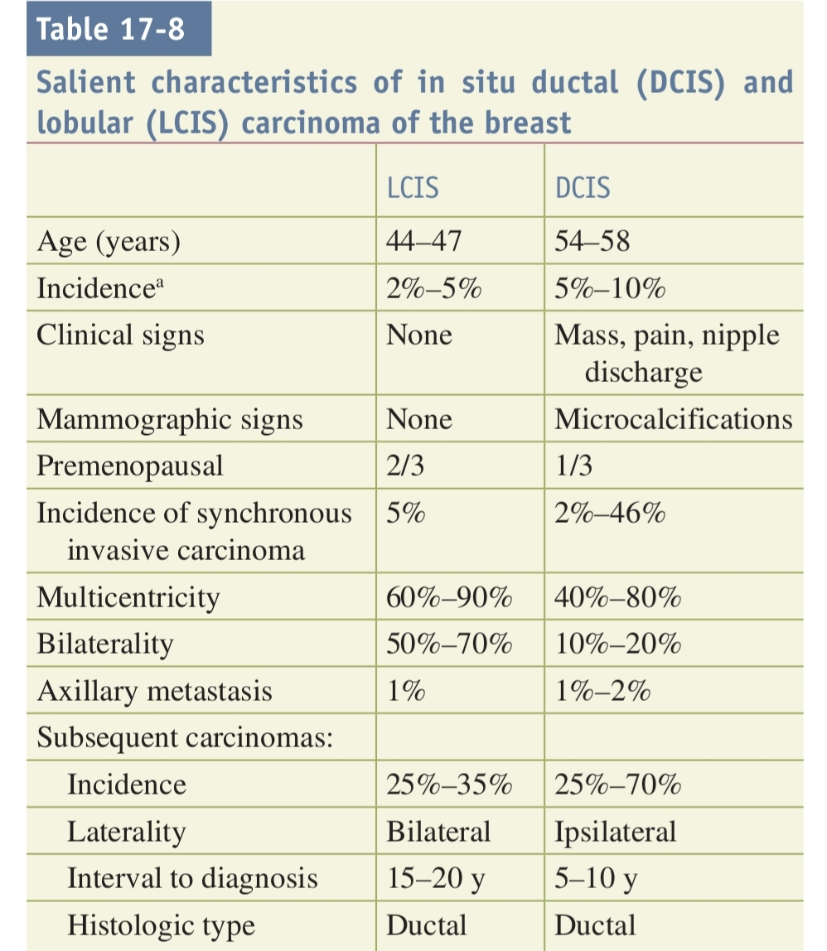
Non invasive

Slide 25
Invasive carcinoma
Invasive ductal carcinoma of NST, 80%
Special types
- Medullary carcinoma, 4%
- Mucinous (colloid) carcinoma, 2%
- Papillary carcinoma, 2%
- Tubular carcinoma, 2%
Invasive lobular carcinoma, 10%
Paget’s disease of the nipple
Rare cancers (adenoid cystic, squamous cell, apocrine)

Slide 26
Cont…
Invasive ductal cancer tends to grow as a cohesive mass;
- it appears as discrete abnormalities on mammograms
- palpable as a discrete lump in the breast.
Invasive lobular cancer tends to permeate the breast in a single-file nature,
- it remains clinically occult and often escapes detection on mammography or physical examination until the disease is extensive.

Slide 27
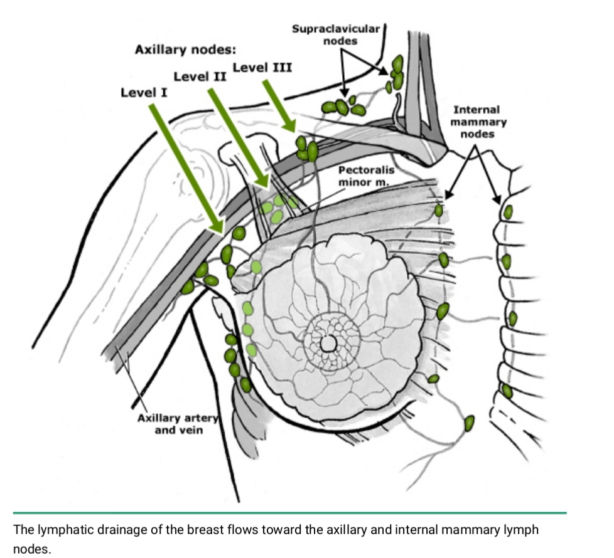
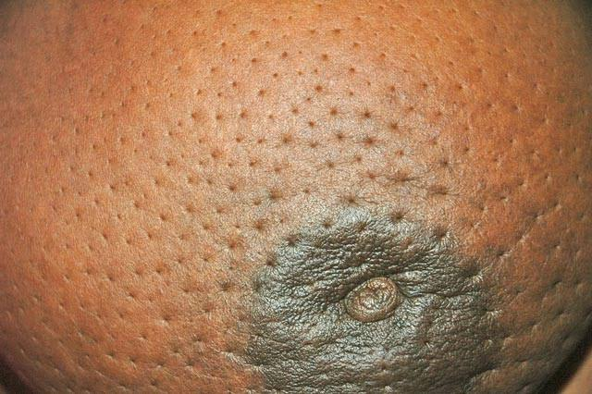
Spread
Directly to surrounding tissue
Lymphatic
Hematogenous

Slide 28
Diagnosis
History (symptoms) & Physical exam
Imaging
Pathology
History & Physical
examination

Slide 29
Imaging
Mammography
Low sensitivity & specificity for women <50yrs of age
Ultrasound
X-tics feature of ca – irregular wall
Used to guide FNAC, Core needle biopsy,
MRI
Highly sensitive and specific
Notes:
The presence of fine, stippled calcium in and around a suspicious lesion is suggestive of breast cancer and occurs in as many as 50% of nonpalpable cancers. These micro-calcifications are an especially important sign of cancer in younger women, in whom it may be the only mammographic abnormality.

Slide 30
Pathology
FNAC
Cytology cannot distinguish invasive from in situ carcinoma, but it can provide a diagnosis of carcinoma.
Sensitivity 94% and specificity of 97%
Core needle biopsy
CNB is the method of choice to sample breast lesions
Excisional biopsy
Notes:
When a breast mass is clinically and mammographically suspicious, the sensitivity and specificity of FNA biopsy approaches 100%.
The advantages of core-needle biopsy include a low complication rate, minimal scarring, a lower cost compared with excisional breast biopsy and single surgical procedure can be planned based on its result.
Less than 10% of patients who undergo CNB have inconclusive results and require surgical biopsy for definitive diagnosis. Biopsy results that are not concordant with the targeted lesion (e.g., a spiculated mass on imaging and normal breast tissue on CNB) necessitate surgical excision. When ADH is found on CNB, surgical excision reveals DCIS or invasive carcinoma in 20% to 30% of cases because of the difficulty of distinguishing ADH and DCIS in a limited
tissue sample. A finding of a cellular fibroadenoma on CNB requires excision to rule out a phyllodes tumor.

Slide 31
Triple assessment of the breast
Clinical Imaging Pathology
Hx P/E US MMG FNA TC
Dx in 95% of cases

Slide 32
TNM Staging
TIS no palpable tu - N0 no nodal metastasis
T1 <2 cm - N1 mobile axillary LNs
T2 2-5 cm - N2 fixed axillary LNs
T3 >5cm - N3 supraclavicular LNs
T4 any size invading skin or chest wall
M0 no distant metastasis
M1 distant metastasis

Slide 33
Staging- four stages
Stage I- T1, N0, M0
Stage II- T1 or T2 or T3 plus N1 but M0
Stage III- T1 or T2 or T3 or T4 plus N2 or N3
Stage IV- Any T, any N plus M1

Slide 34
Curative treatment
Local treatment
Breast conserving and radiotherapy
Modified radical mastectomy
Systemic treatment- Adjuvant therapy
Hormonal
Chemotherapy

Slide 35
Palliative treatment
Radiotherapy
Hormonal therapy
chemotherapy

Slide 36
Prognosis
Best indicators are size and LN status
5 yrs survival
Stage 1 84%
Stage 2 71%
Stage 3 48%
Stage 4 18%

Slide 37
Spread of breast ca.
Local
Lymphatic
Blood stream

Slide 38
Oher breast lesions
Fibroadenosis
Fibroadenoma
Duct papilloma
Traumatic fat necrosis
Infection or inflammation of the breast

Slide 39
Fibroadenoma
Usually occur around 15-25yrs
Most common benign breast lesion
Arise from hyperplasia of single lobule
Usually attain size of 2-3 cm
Mobile (mouse like)
Usually needs no Rx
Giant FA (>5cm) occasionally occur in puberty

Slide 40
Fibroadenosis
Benign breast condition
Causes lumpiness and tenderness
Hormone related and occurs between menarche and premenaupause
Common 30-50 years
Cyclical pain
Lump changing in size
Rx- conservative rarely surgery

Slide 41
Phylloids tumor
Occur over the age of 40 yrs
Massive tumor With occasional ulceration
Rarely have malignant type
Rx. enucleating for benign
Rx. Mastectomy for massive, recurrent and malignant types

Slide 42
Paget’s disease of the nipple
Manifestation of underlying breast ca.
Eczema like appearance
Can erode remove the nipple
Difference from infectious eczema
-unilateral
-no response to antibiotics
-no fever

Slide 43
Inflammatory lesions
Acute mastitis / abscess
Associated with lactation, due to cracks in nipple
Also associated with eczema and nipple dermatoses
Usually due to Staphylococcus or Streptococcus
Rx – antibiotics and abscess drainage

Slide 44
END

